Slide 1
Comprehensive Plan Update
Spring of 2025, status review and next steps

Slide 2
Comprehensive Plan Periodic Update, Chapter 36.70A RCW Significant Changes include:
Climate Element. Under HB 1181, requires climate change element and resiliency sub-element. Will affect land use, capital facilities, parks & recreation, utilities and transportation.
Housing Element. Under HB 1220 and 1337, requires planning for housing by income band, emergency housing, addressing of racial disparities, and allowance of at least two ADUs in UGAs.
Critical Areas. Special consideration for anadromous fish species, No Net Loss requirement, clarity between CAs occurring within shorelines and upland areas, and standardized buffer widths. Consultants have completed GAP Analysis.

Slide 3
Critical Area Ordinance Update, Gap Analysis
Main areas of consideration
Update policies to include no net loss for consistency with GMA
Providing clarity on relationship of Shoreline Master Plan and CAO
Update wetland delineation, ratings system and qualifications of wetland professionals
Revise wetland buffers to meet Ecology’s recommendations and standardizations
Update stream and wildlife habitat conservation area classifications
Stream protection standards, including riparian area management, vegetation requirements, and mitigation
Update hazard tree and vegetation removal requirements
Revise wastewater, dewatering, and allowed activities provisions in CARAs
Clarify and ensure consistency of regulated activities and exemptions

Slide 4
The Challenge of Housing:
Affordability defines as 30% of Net Income.
2024 AMI: $64,000 individual; $94,000 Family of 4.
Current median house price: $451,000 in PA, $579,000 in Sequim (Zillow.com, 4/28/25).
Affordability for individual: $250k; Family of 4: $350k

Slide 5
Future Housing Allocations
Utilizing the Department of Commerce’s Housing for All Planning Tool (HAPT) with moderate growth projections, the County’s future housing needs are projected to increase by:
PSH = Permanent Supportive Housing
AMI = Area Median Income
Notes:
2024
AMI – Individual = $64,000
AMI – Family of 4 = $93,900

Slide 6
Steps to Address Housing Deficiencies—What we can do.
Lands Capacity Analysis currently identifies deficiencies in low to extremely low-income segments in Sequim UGA and Clallam Bay/Sekiu UGA. Suggest implementing higher density (> 10 du/acre) zoning in these areas.
Suggest allocating more higher-density zoning than is minimally necessary to ensure adequate opportunity for townhouse and multi-family developments.
Expand ADU opportunities in UGAs.
Suggest eliminating TDR program
Work with Cities to update and establish equitable service extension and annexation agreements. Help to facilitate engineered designs for shovel-ready projects.
Recognize the economic prosperity is part of the solution to housing affordability.

Slide 7
Economic Development Issues:
EDC 2023 Five-Year Plan identified Construction, Forest Products, and Manufacturing and Maritime as sectors providing economic prosperity.
Opportunity exists primarily in the County’s industrial land base.
Consideration should be given to proximity to other industrial areas, transportation corridors and provision of adequate urban services.
Size matters. Many industries require larger consolidated tracts to establish viable businesses.

Slide 8
Employment Allocations

Slide 10
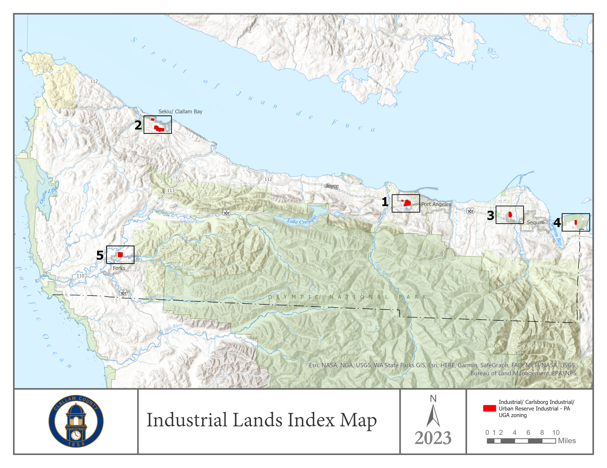

Slide 11
Accomplishments to Date:
Gap Analysis
BAS Report
Housing allocations
Climate Vulnerability Analysis & Policy
Community Survey with 463 responses
LCA nearly complete
Draft mandatory changes nearly complete

Slide 12
What we’re doing next:
Continued Public Outreach
Draft Periodic Update document release
Press release
Commerce review
SEPA checklist & Threshold Determination
Public Comment
Open House events
BOCC & PC workshops
Planning Commission Recommendations
BOCC Approval (due 12/31/25)

Slide 13
Presentation created in coordination with the County’s consultant, Facet NW, Inc.
Contacts:
Bruce Emery, Director, DCD – (360) 417-2323, bruce.emery@clallamcountywa.gov
Tim Havel, Deputy Director, DCD – (360) 417-2563, tim.havel@clallamcountywa.gov

